Slide 1


HUM 102 Report Writing Skills
Lecture 24

Slide 2

Previous Lecture
Basics of Plagiarism
Quotations
Citations
Paraphrasing
Tips to Avoid Plagiarism

Slide 3



Referencing Style
Citation
Documentation of original source
Street address for the quote
Reference to a published/ unpublished source
Goes parallel with your writing
Not to be overlooked
Mark all the sites for citations

Slide 4
Referencing Style
What needs to be documented?
When exact words or a unique phrases have been copied.
When ideas presented in a book, magazine, newspaper, web page, TV program, letter, advertisement or any other medium have been incorporated in work.
When any diagrams, illustrations, charts, pictures or other visual material has been reprinted.
When information is gained through interviewing or conversing with another person, face to face, on phone or in writing.
When any electronically available material including images, audio or video has been reused.

Slide 5
Referencing Style
Why must we cite?
To acknowledge and give credit to sources of words, ideas, diagrams, illustrations, quotations borrowed, or any materials summarized or paraphrased.
To show that you are respectfully borrowing other people’s ideas, not stealing them, i.e., to prove that you are not plagiarizing.
To enhance the credibility of your research. By giving the readers an opportunity to check out your sources for accuracy, you inspire reader confidence.

Slide 6
Referencing Style
HEC’s Plagiarism Policy
In the special meeting of the commission held on 14th of April 2007, the following was decided:
“To preserve academic honesty and sanctity of the degrees awarded by the Universities and Degree Awarding Institutes in Pakistan, HEC will have a zero tolerance policy towards any kind of Plagiarism.”

Slide 7
Referencing Style
What need not to be documented?
Writing your own lived experiences, your own observation and insight, your own thoughts and your own conclusions about a subject.
When you are writing up your own obtained results through lab or field experiments.
When you use your own art work, digital photographs, audio and video.
When you use “common knowledge”- things like folklore, common sense observations, myths, urban legends and historical events (but not historical documents).

Slide 8
Referencing Style
Methods of Citation
Footnotes
Endnotes
Parenthetical References

Slide 9
Referencing Style
Footnotes
Place a superscript number after the last word of the quotation.
Place the same superscript number at the beginning of the Footnote at the bottom of the same page where the citation occurs.
Example:
In traditional British East Africa, there are certain social and cultural restrictions for young females.⁶
[6] Sigmund Freud, Totem and Taboo (New York: Random, 1918) 17.
In your work cited page, you write:
Freud, Sigmund. Totem and Taboo. New York: Random, 1918.

Slide 10
Referencing Style
Endnotes
Endnotes are written in the same way as footnotes.
The main difference is that footnotes are placed numerically at the foot of the very same page where direct references are made, while Endnotes are placed numerically at the end of the essay on a separate page entitled End notes or notes. Example:
The World Book Encyclopedia defines Taboo as “an action, object, person, or place forbidden by law or culture.”¹
[1] Alan Dundes, "Taboo," World Book Encyclopedia. 2000 ed.
In your work cited page, you write:
Dundes, Alan. "Taboo." World Book Encyclopedia. 2000 ed.

Slide 11
Referencing Style
Parenthetical references
It is the simplest way to cite sources.
The author's last name and page number(s) are placed in parentheses in the text to give credit to sources. Example:
In their Preface, the authors point out that "Learning Hypertext Markup Language (HTML) and Extensible Hypertext Markup Language (XHTML) is like learning any new language, computer or human" (Musciano and Kennedy xi).
In your bibliography or work cited page you write
Musciano, Chuck, and Bill Kennedy. HTML and XHTML: The Definitive Guide. 4th ed. Sebastopol, CA: O'Reilly, 2000.

Slide 12
Referencing Style
Referencing Styles
APA
MLA
Oxford
Harvard
Chicago

Slide 13
Referencing Style
Modern Language Association (MLA) [1/4]
Direct Quotes: Less than 4 lines are placed within a paragraph enclosed within quotation marks
Mention the author’s last name and page number
Joseph Conrad writes of the company manager in Heart of Darkness, “He was obeyed, yet he inspired neither love nor fear, nor even respect” (87)
“The red tree vole is a crucial part of the spotted owl's diet” (Moone 15)

Slide 14
Referencing Style
Modern Language Association (MLA) [2/4]
Block Quotes: quotations longer than 4 lines
Placed separately indented by 1 inch
At the conclusion of Lord of the Flies, Ralph and the other boys realize the horror of their actions:
The tears began to flow and sobs shook him. He gave himself up to them now for the first time on the island; great, shuddering spasms of grief that seemed to wrench his whole body. His voice rose under the black smoke before the burning wreckage of the island; and infected by that emotion, the other little boys began to shake and sob too. (186)

Slide 15
Referencing Style
Modern Language Association (MLA) [3/4]
Indirect Quote: First suggestion is that try to cite directly
Name the primary source in your original phrase
Include the secondary source in parentheses with qtd. in (quoted in)
Include indirect source in work cited list. For example:
Jackson stated that... (qtd. in Johns 14)

Slide 16
Referencing Style
Modern Language Association (MLA) [4/4]
In case of 2-3 authors:
Studies have shown that more and more teachers are changing careers after their first year of teaching. (Posamentier, Jaye, and Krulik 55)
In case of more than 3 authors:
Stutts et. al. argue that language development may also impact development in related parts of the brain (339)

Slide 17
Referencing Style
Works Cited List [1/2]
In case of a Book: Lastname, Firstname. Title of Book. City: Publisher, Year. Format
Picoult, Jodi. The Storyteller: A Novel. New York: Emily Bestler, 2013. Print
Posamentier, Alfred S., Daniel Jaye, and Stephen Krulik. Exemplary Practices for Secondary Math Teachers.
Alexandria: Assn. for Supervision and Curriculum Development, 2007. Print.
Article in a Reference Book: Brown, William F. “Collie.” Encyclopedia Americana. Deluxe Library ed. 1997. Print.
In case of an E-Book: Rowley, Hazel. Franklin and Eleanor: An Extraordinary Marriage. New York: Farrar, 2010. Kindle file

Slide 18
Referencing Style
Works Cited List [2/2]
Lastname, Firstname. “Article Title.” Journal Title volume. issue (year): page numbers. Database name if applicable. Web. Day month year accessed
In case of Online Magazine Article: Duplet, Franc. “How to Duplicate the Success of a Business.” Successful Jobs Oct. 2003: 55-58. General Business File. Web. 28 Dec. 2008
In case of Online Journal Article: Liller, Karen D. “Let's Sell Health.” Journal of School Health 75.5 (2005): 187-188. Academic Search Premier. Web. 2009
In case of Online Newspaper Article: Robs, Jake. “10 Tips for Negotiating a House Offer.” Miami Herald 14 June 2008: C1+. America's Newspapers. Web. 9 Nov. 2008

Slide 19
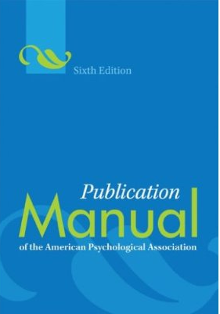
Referencing Style
What is APA?
The American Psychological Association (APA) citation style is the most commonly used format for manuscripts in the social sciences.
Author-Date Citation System

Slide 20
Referencing Style
Manuscript format [1/2]
You should:
Use a serif typeface, as New Times Roman, for the text. Use a sans serif typeface, as Ariel, for the figure labels.
Double-space the entire manuscript, between body text, titles, headings, block quotations , reference list and figure captions.
Indent first line of every para one -half inch.
Align text to left-hand margin, leaving a rough right hand margin.

Slide 21
Referencing Style
Manuscript format [2/2]
You should:
Print on standard-sized paper (8.5”x11”) (Letter)
Use 1” margins on all sides
Use 12 pt. Times New Roman or a similar font
Include a page header (running head) in the upper left-hand of every page and a page number in the upper right-hand side of every page
Running head be less than 50 characters

Slide 22
Referencing Style
Page 1: Title Page
Running head: capitalized, top left hand corner
Page number: top right-hand corner
Full title of paper: centered, upper and lower case letters (<12 words)
Name of author: centered
Author’s affiliation: centered
Author’s note with more info about affiliation: bottom of page
Double spaced

Slide 23
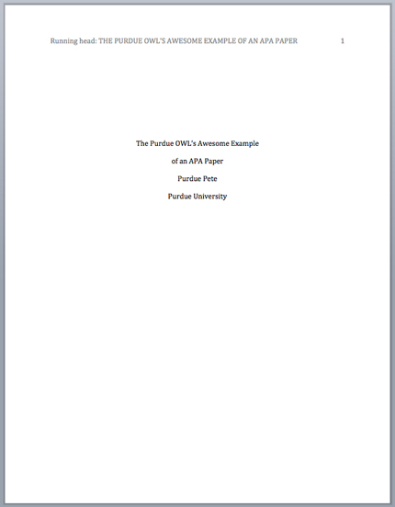
Referencing Style
Page 1: Title Page Sample
Page header:
(use Insert Page Header)
title flush left + page number flush right.
Title:
(in the upper half of the page, centered)
name (no title or degree) + affiliation (university, etc.)

Slide 24
Referencing Style
Page 2: Abstract
Left aligned and justified
150-250 words
For keywords, first indent and then italicize

Slide 25
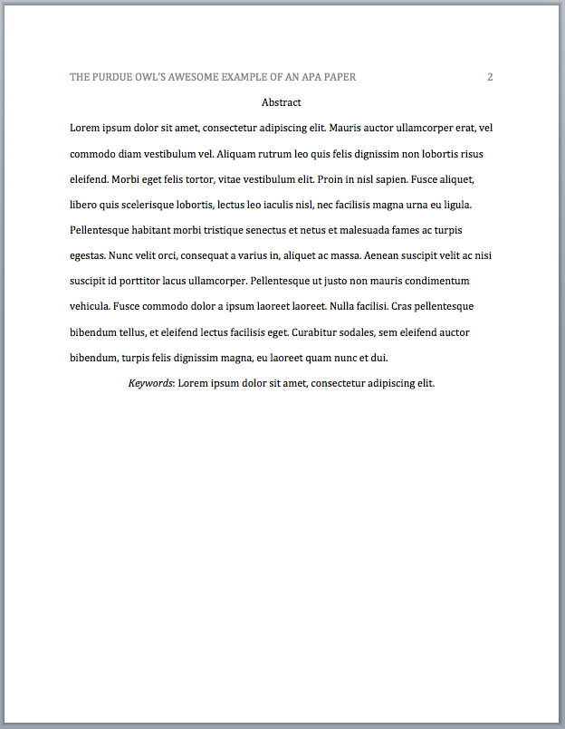
Referencing Style
Page 2: Abstract Sample
Page header: do NOT include “Running head:”
Abstract: Left aligned, at the top of the page
Write a 150- to 250- word summary of your paper in an accurate, concise, and specific manner.

Slide 26
Referencing Style
Page 2: Main Body (Text)
Title of the paper centered at the top of the page
Double-spacing with all sections following each other without a break
Identify the sources you use in the paper in parenthetical in-text citations

Slide 27
Referencing Style
In-text Citations: Basics
This means that the author's last name and the year of publication for the source should appear in the text, e.g., (Ahmad, 2016).
In-text citations help readers locate the cited source in the References section of the paper.
Whenever you use a source, provide in parenthesis:
the author’s name and the date of publication
for quotations and close paraphrases, provide the author’s name, date of publication, and a page number

Slide 28
Referencing Style
In-text Citations: Formatting Quotations
When quoting, introduce the quotation with a signal phrase. Make sure to include the author’s name, the year of publication, the page number, but keep the citation brief – do not repeat the information. For example:
Caruth (1996) states that a traumatic response frequently entails a “delayed, uncontrolled repetitive appearance of hallucinations and other intrusive phenomena” (p.11).
A traumatic response frequently entails a “delayed, uncontrolled repetitive appearance of hallucinations and other intrusive phenomena” (Caruth, 1996, p.11).

Slide 29
Referencing Style
In-text Citations: Formatting a Summary or Paraphrase
Provide the author’s last name and the year of publication in parenthesis after a summary or a paraphrase.
For example:
Though feminist studies focus solely on women’s experiences, they err by collectively perpetuating the masculine-centered impressions (Fussell, 1975).

Slide 30
Referencing Style
In-text Citations: Formatting a Summary or Paraphrase
Several authors with different dates: Include the authors name in a signal phrase followed by the year of publication in parenthesis.
For example:
Recently, the history of warfare has been significantly revised by Higonnet et al. (1987), Marcus (1989), and Raitt and Tate (1997) to include women’s personal and cultural responses to battle and its resultant traumatic effects.

Slide 31
Referencing Style
In-text Citations: Signal Words/Phrases
Introduce quotations with signal phrases, e.g.
According to X. (2008), “…” (p. 3).
X. (2008) argued that “…” (p. 3).
Use such signal verbs as:
acknowledged, contended, maintained, responded, reported, argued, concluded, etc.
Use the past tense or the present perfect tense of verbs in signal phrases

Slide 32
Referencing Style
In-text Citations: A Work with Two Authors
When citing a work with two authors, use “and” in between authors’ name in the signal phrase yet “&” between their names in parenthesis.
According to feminist researchers Raitt and Tate (1997), “It is no longer true to claim that women’s responses to the war have been ignored” (p. 2).
Some feminists researchers question that “women’s responses to the war have been ignored” (Raitt & Tate, 1997, p. 2).

Slide 33
Referencing Style
In-text Citations: A Work with Three to Five Authors
When citing a work with three to five authors, identify all authors in the signal phrase or in parenthesis.
(Harklau, Siegal, and Losey, 1999)
In subsequent citations, only use the first author’s last name followed by “et al.” in the signal phrase or in parentheses.
(Harklau et al., 1993)

Slide 34
Referencing Style
In-text Citations: A Work with Six and More Authors
When citing a work with six and more authors, identify the first author's name followed by “et al.”
Smith et al. (2006) maintained that…
(Smith et al., 2006)

Slide 35
Referencing Style
In-text Citations: Organization
When citing an organization, mention the organization the first time when you cite the source in the signal phrase or the parenthetical citation.
The data collected by the Food and Drug Administration (2008) confirmed that…
If the organization has a well-known abbreviation, include the abbreviation in brackets the first time the source is cited and then use only the abbreviation in later citations.
Food and Drug Administration (FDA) confirmed… FDA’s experts tested…

Slide 36
Referencing Style
In-text Citations: Same Last Name or Same Author
When citing authors with the same last names, use first initials with the last names.
(B. Kachru, 2005; Y. Kachru, 2008)
When citing two or more works by the same author published in the same year, use lower-case letters (a, b, c) with the year of publication to order the references.
Smith’s (1998a) study of adolescent immigrants…

Slide 37
Referencing Style
In-text Citations: Personal Communication
When citing interviews, letters, e-mails, etc., include the communicator’s name, the fact that it was personal communication, and the date of the communication.
Do not include personal communication in the reference list.
A. P. Smith also claimed that many of her students had difficulties with APA style (personal communication, November 3, 2002).
(E. Robbins, personal communication, January 4, 2001).

Slide 38
Referencing Style
In-text Citations: Electronic Sources
When citing an electronic document, whenever possible, cite it in the author-date style.
If electronic source lacks page numbers, locate and identify paragraph number/paragraph heading.
According to Smith (1997), ... (Mind over Matter section, para. 6).

Slide 39
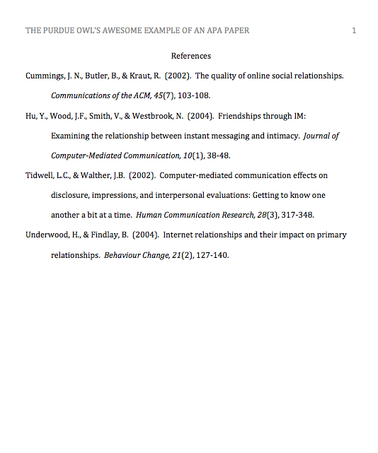
Referencing Style
Reference Page
Center the title (References) at the top of the page. Do not bold it.
Double-space reference entries
Flush left the first line of the entry and indent subsequent lines
Order entries alphabetically by the author’s surnames

Slide 40
Referencing Style
Reference Basics [1/2]
Invert authors’ names (last name first followed by initials: “Smith, J.Q.”)
Alphabetize reference list entries the last name of the first author of each work
Capitalize only the first letter of the first word of a title and subtitle, the first word after a colon or a dash in the title, and proper nouns. Do not capitalize the first letter of the second word in a hyphenated compound word.

Slide 41
Referencing Style
Reference Basics [2/2]
Capitalize all major words in journal titles
Italicize titles of longer works such as books and journals
Do not italicize, underline, or put quotes around the titles of shorter works such as journal articles or essays in edited collections

Slide 42
Referencing Style
Making the References List
APA is a complex system of citation. When compiling the reference list, the strategy below might be useful:
Identify the type of source: Is it a book? A journal article? A webpage?
Find a sample of citing such source in the textbook or in OWL APA Guide: http://owl.english.purdue.edu/owl/resource/560/01/
“Mirror” the sample
Make sure that the entries are listed in the alphabetical order and the subsequent lines are indented (Recall References: Basics)

Slide 43
Referencing Style
APA Tables
Label tables with an Arabic numeral and provide a title. The label and the title appear on separate lines above the table, flush-left and single-spaced.
Cite a source in a note below the table.
Table 1 : Internet users in Europe
Note: The data are adapted from “The European Union and Russia” (2007). Retrieved from http://epp.eurostat.ec.europa.eu
Country | Regular users
France | 9 ml

Slide 44
Referencing Style
Book: Format & Example
Author’s last name, first initial. (Publication date). Book title. Additional information. City of publication: Publishing company.
Allen, T. (1974). Vanishing wildlife of North America. Washington, D.C.: National Geographic Society.
Boorstin, D. (1992). The creators: A history of the heroes of the imagination. New York: Random House.

Slide 45
Referencing Style
Encyclopedia &Dictionary: Format & Example
Author’s last name, first initial. (Date). Title of Article. Title of Encyclopedia (Volume, pages). City of publication: Publishing company.
Bergmann, P. G. (1993). Relativity. In the new encyclopedia britannica (Vol. 26, pp. 501-508). Chicago: Encyclopedia Britannica.
Merriam-Webster's collegiate dictionary (10th ed.). (1993). Springfield, MA: Merriam-Webster.

Slide 46
Referencing Style
Magazine and Newspaper Article: Format & Example
Author's last name, first initial. (Publication date). Article title. Periodical title, volume number(issue number if available), inclusive pages.
pp or p without volume number/ in case of newspapers in APA
Harlow, H. F. (1983). Fundamentals for preparing psychology journal articles. Journal of Comparative and Physiological Psychology, 55, 893-896.
Henry, W. A., III. (1990, April 9). Making the grade in today's schools. Time, 135, 28-31.
Trillin, C. (1993, February 15). Culture shopping. New Yorker, pp. 48-51.

Slide 47
Referencing Style
Website or Webpage: Format & Example [1/2]
In case of Online Periodical: Author's name. (Date of publication). Title of article. Title of Periodical, volume number, Retrieved month day, year, from full URL
In case of Online Document: Author's name. (Date of publication). Title of work. Retrieved month day, year, from full URL

Slide 48
Referencing Style
Website or Webpage: Format & Example [2/2]
Devitt, T. (2001, August 2). Lightning injures four at music festival. The Why? Files. Retrieved January 23, 2002, from http://whyfiles.org/137lightning/index.html
Dove, R. (1998). Lady freedom among us. The Electronic Text Center. Retrieved June 19, 1998, from Alderman Library, University of Virginia website: http://etext.lib.virginia.edu/subjects/afam.html
Note: If a document is contained within a large and complex website (such as that for a university or a government agency), identify the host organization and the relevant program or department before giving the URL for the document itself. Precede the URL with a colon.
Fredrickson, B. L. (2000, March 7). Cultivating positive emotions to optimize health and well-being. Prevention & Treatment, 3, Article 0001a. Retrieved November 20, 2000, from http://journals.apa.org/prevention/volume3/pre0030001a.html
GVU's 8th WWW user survey. (n.d.). Retrieved August 8, 2000, from http://www.cc.gatech.edu/gvu/usersurveys/survey1997-10/
Health Canada. (2002, February). The safety of genetically modified food crops. Retrieved March 22, 2005, from http://www.hcsc.gc.ca/english/protection/biologics_genetics/gen_mod_foods/genmodebk.html
Hilts, P. J. (1999, February 16). In forecasting their emotions, most people flunk out. New York Times. Retrieved November 21, 2000, from http://www.nytimes.com

Slide 49
Referencing Style
Additional APA Resources
The Purdue OWL http://owl.english.purdue.edu
Purdue Writing Lab @ HEAV 226
Composition textbooks
Publication Manual of the American Psychological Association, 6th ed.
APA’s website http://www.apastyle.org
https://www.sciencebuddies.org/science-fair-projects/science-fair/writing-a-bibliography-apa-format

Slide 50
Referencing Style
Citation Made Easy
Microsoft Word
Citefast
Bib.me
Zotero

Slide 51
References
Lane Community College Library. (2013). MLA Style Quick Sheet. Retrieved from https://library.lanecc.edu/sites/default/files/handouts/mla_quick.pdf
University of Waikato. (2016). APA Referencing. Retrieved from http://www.waikato.ac.nz/__data/assets/pdf_file/0014/236120/apa-quick-guide.pdf

Slide 52
Conclusions
Methods of Citation
Referencing Styles

